Slide 1
DUCG Applied In Fault Diagnosis and PSA Dynamic Uncertain Causality Graph
Qin Zhang
Prof. of Tsinghua University, member of INEA
CAAI Fellow, Director of Specialized Committee of UAI
Hangzhou, June 10, 2023

Slide 2
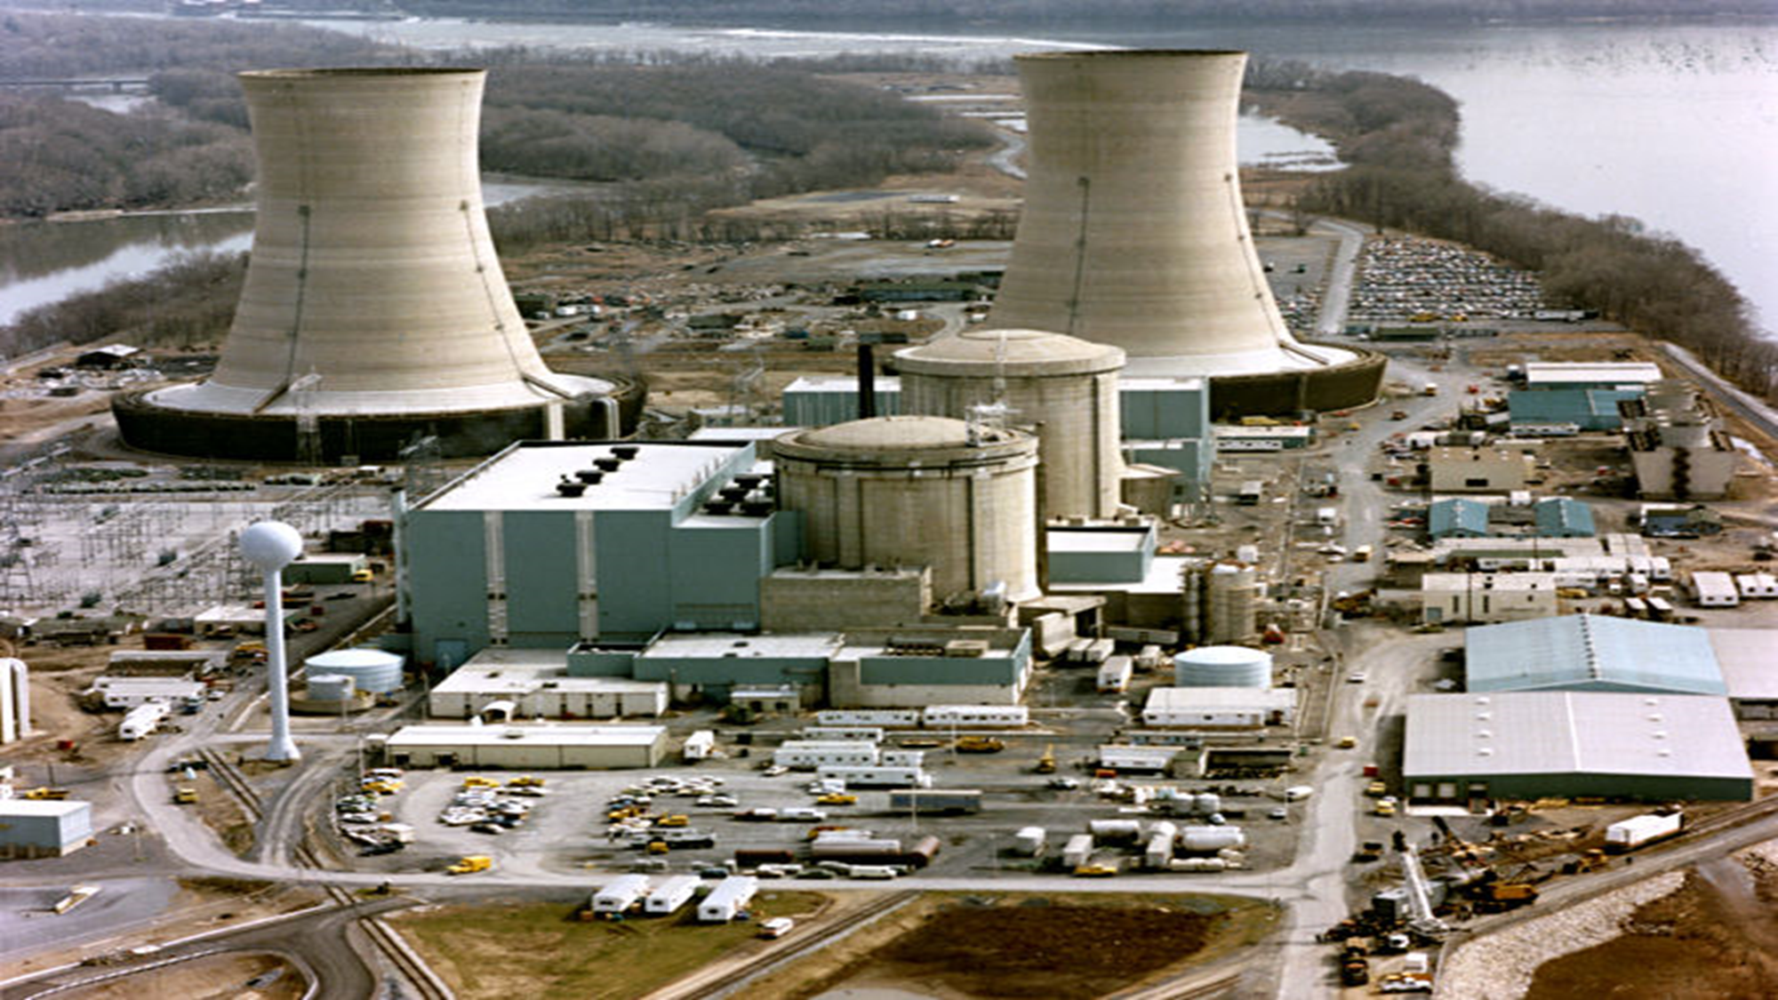
目录
Nuclear Power Plant at Three Mile Island, USA
这里可以写你的目录内容
一
二
三

Slide 3
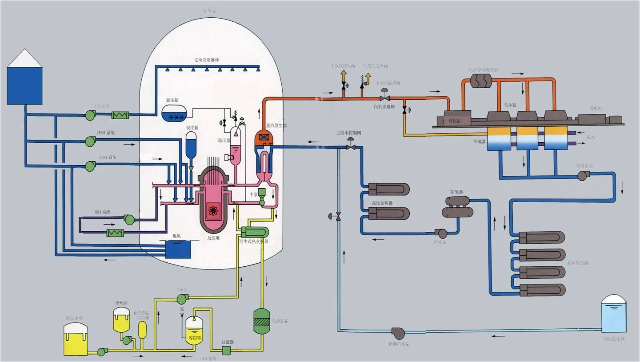
Misdiagnosis Influenced By Spurious Signal Causes Serious Accident

Slide 4
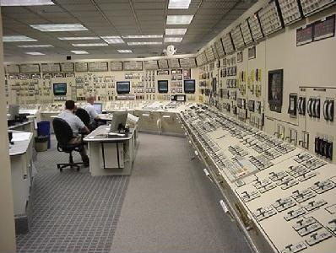
AI is needed to online diagnose novel faults with unknown spurious signals without failure data

Slide 5
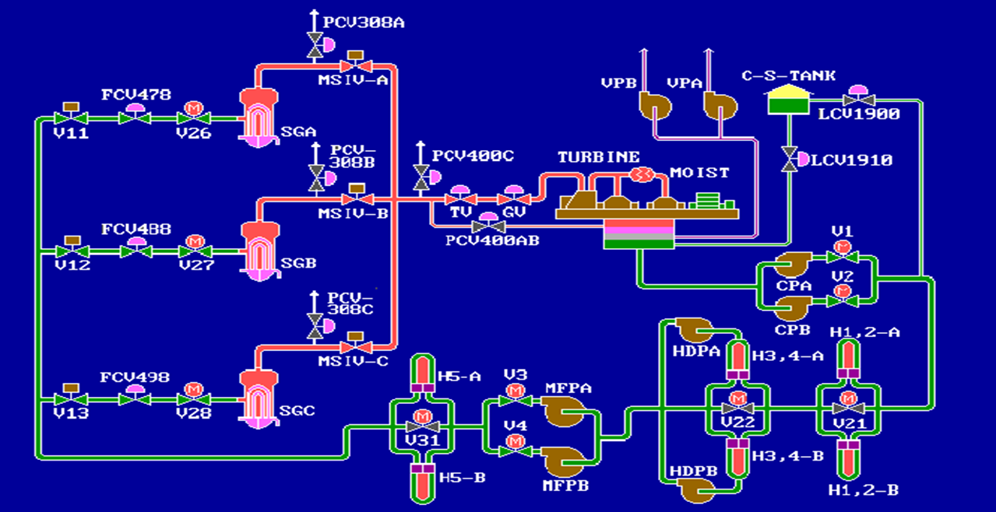
Diagnosis for the Secondary Loop of a NPP

Slide 6
X₁₄
B₉₀
X₂₄
B₁₁₉
The Constructed DUCG
X₁₇
B₁₁₇
X₁₆
G₉₈
B₉₇
B₉₅
X₆₁
B₁₁₆
X₁₅
X₄₉
X₂₅
B₁₂₀
X₃₂
X₆₂
X₁₃
X₅₀
B₈₅
B₈₆
B₇₅
B₉₆
X₅₁
B₈₇
B₇₁
G₇₆
X₃₅
X₃₆
X₃₇
indicates component failure
indicates signal
indicates logic gate
indicates uncertain causality
indicates conditional uncertain
causality
X₃₃
n
B₇₉
B₉₂
B₁₀₀
B₈₀
B₉₃
B₁₀₁
B₁₁₀
B₁₁₁
B₁₁₅
B₁₀₂
B₈₁
B₉₄
n
X₃₄
X₁
X₁₀
X₂
X₁₁
X₁₈
X₃
X₁₂
B₇₂
X₂₃
n
G₂₉
G₃₀
B₉₉
G₃₁
B₈₂
B₈₃
X₂₆
B₈₄
X₅₅
X₄
X₇
X₅₆
X₅
X₈
X₆
X₅₇
X₉
B₆₅
B₆₈
B₁₀₇
B₁₁₂
X₂₂
B₆₆
B₆₉
B₁₀₈
B₁₁₃
B₆₇
B₇₀
B₁₀₉
B₁₁₄
X₅₂
X₅₃
X₅₄
X₄₃
B₁₀₅
X₂₁
B₁₀₆
X₄₄
X₄₅
B₇₇
B₇₈
X₄₆
X₂₇
B₇₃
X₂₀
B₇₄
X₂₈
X₃₈
B₁₀₃
B₁₀₄
X₃₉
X₄₇
B₆₃
X₁₉
B₆₄
X₄₈
B₈₈
B₈₉

Slide 7
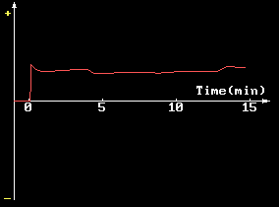
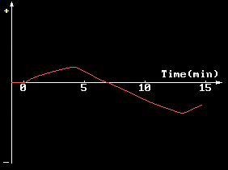
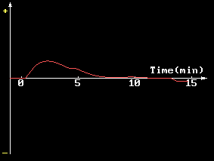
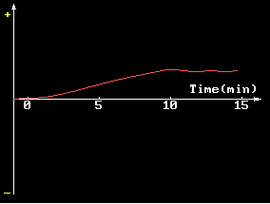
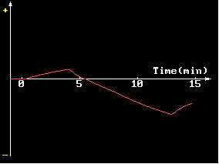
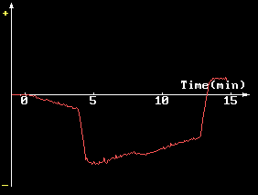
Abnormal Signals Observed Online
Steam flow rate of SGC Steam pressures Water level of SGC
Water level of hot well Average steam temperature Nuclear power

Slide 8
Fault Diagnosis and Prediction at t1
X_{15,0}
B_{102,1}
X_{12,0}
Fault diagnosis at t1
X_{23,0}
X_{3,0}
X_{6,2}
X_{15,2}
B_{102,1}
X_{12,2}
One step prediction
X_{23,2}
X_{6,2}
X_{3,2}
X_{16,2}
X_{15,2}
X_{12,2}
X_{26,1}
B_{102,1}
X_{23,2}
X_{1,2}
Two step prediction
X_{4,1}
X_{6,2}
X_{5,1}
X_{3,2}
X_{13,2}
X_{2,2}

Slide 9
Fault Diagnosis and Prediction at t2
X_{15,0}
X_{12,2}
X_{13,2}
B_{102,1}
Fault diagnosis at t2
X_{1,2}
X_{2,2}
X_{23,2}
X_{3,2}
X_{6,2}
X_{26,1}
X_{49,1}
X_{50,1}
X_{51,1}
X_{15,2}
X_{12,2}
Two step prediction
X_{16,2}
X_{13,2}
B_{102,1}
X_{57,1}
X_{9,1}
X_{3,2}
X_{6,2}
X_{1,2}
X_{55,1}
X_{2,2}
X_{56,1}
X_{23,2}
X_{26,1}
X_{23,1}
X_{26,2}

Slide 10
The Online Generated 3D DUCG（t1）
t₁
X_{15,0}
B_{102,1}
X_{12,0}
X_{23,0}
X_{3,0}
X_{6,2}
t₂
t₃
t₄
t₅

Slide 11
The Online Generated 3D DUCG（t2）
t₁
B_{102,1}
X_{6,2}
X_{13,2}
X_{15,0}
t₂
X_{1,2}
X_{2,2}
X_{12,2}
X_{23,2}
X_{3,2}
X_{6,2}
X_{26,1}
t₃
t₄
t₅

Slide 12
The Online Generated 3D DUCG（t3）
t₁
B_{102,1}
X_{6,2}
X_{13,2}
t₂
X_{1,2}
X_{2,2}
X_{12,2}
X_{23,2}
X_{3,2}
X_{6,2}
X_{26,1}
X_{15,2}
t₃
X_{26,1}
X_{6,2}
t₄
t₅

Slide 13
The Online Generated 3D DUCG（t4）
t₁
B_{102,1}
X_{6,2}
X_{13,2}
t₂
X_{1,2}
X_{2,2}
X_{12,2}
X_{23,2}
X_{3,2}
X_{6,2}
X_{26,1}
X_{15,2}
t₃
X_{26,1}
X_{6,2}
X_{13,1}
X_{15,2}
t₄
X_{1,1}
X_{2,1}
X_{3,1}
X_{23,1}
X_{6,2}
X_{26,1}
t₅

Slide 14
The Online Generated 3D DUCG（t5）
t₁
B_{102,1}
X_{6,2}
X_{13,2}
t₂
X_{1,2}
X_{2,2}
X_{12,2}
U1
U2
U3
Ut
Uτ
X_{23,2}
X_{3,2}
X_{6,2}
X_{26,1}
X1
X2
X3
…
Xt
…
Xτ
t₃
X_{15,2}
Y1
Y2
Y3
Yt
Yτ
X_{26,1}
X_{6,2}
X_{13,1}
X_{15,2}
t₄
X_{1,1}
X_{2,1}
X_{3,1}
First-Order Markov DBN
X_{23,1}
X_{6,2}
X_{26,1}
X_{13,1}
X_{15,2}
t₅
X_{3,1}
X_{1,1}
X_{2,1}
X_{23,1}
X_{6,2}
X_{26,2}

Slide 15
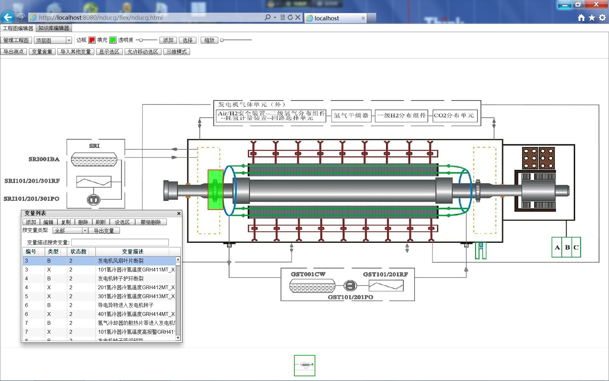
Place Failures on the Graph

Slide 16
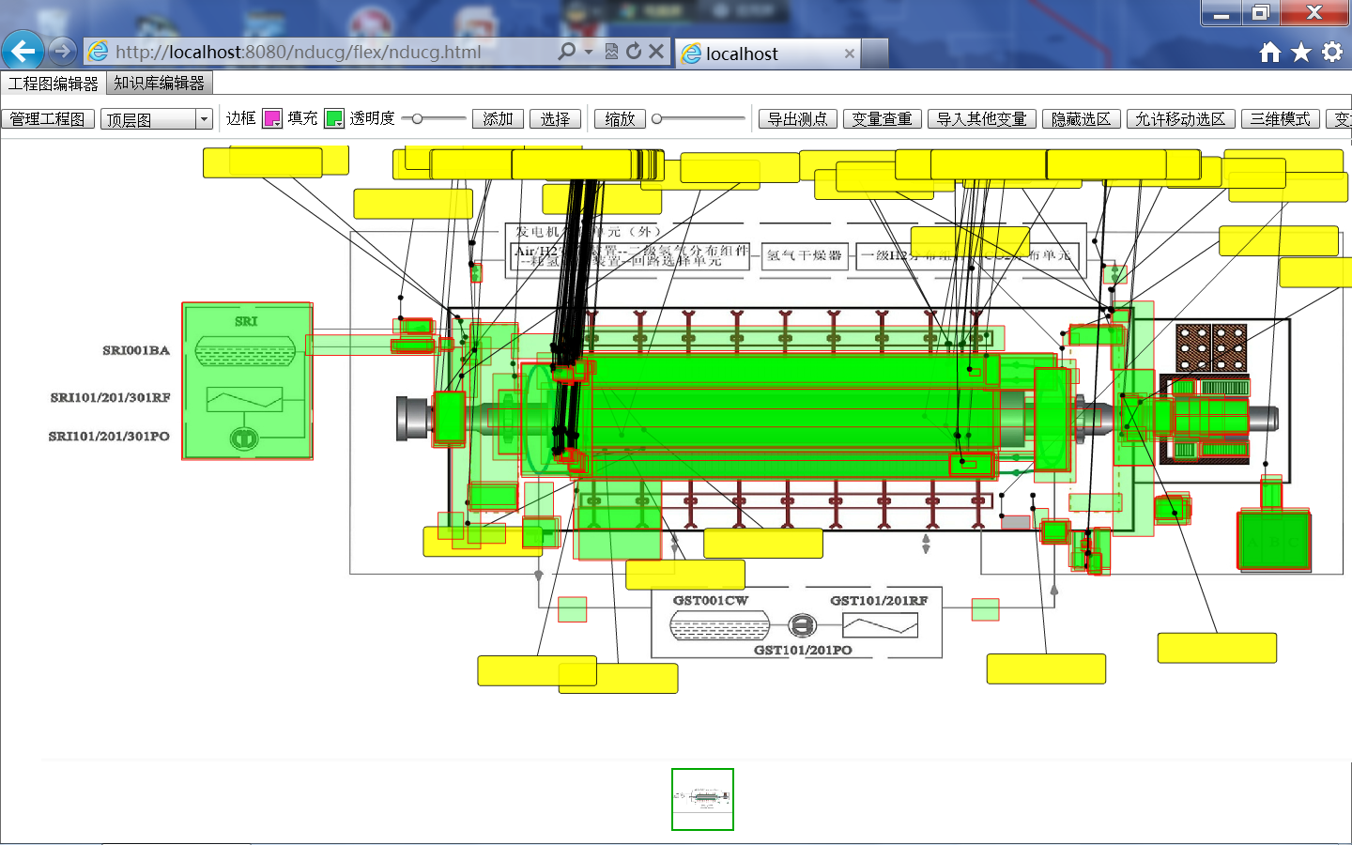
Place Signals on the Graph

Slide 17
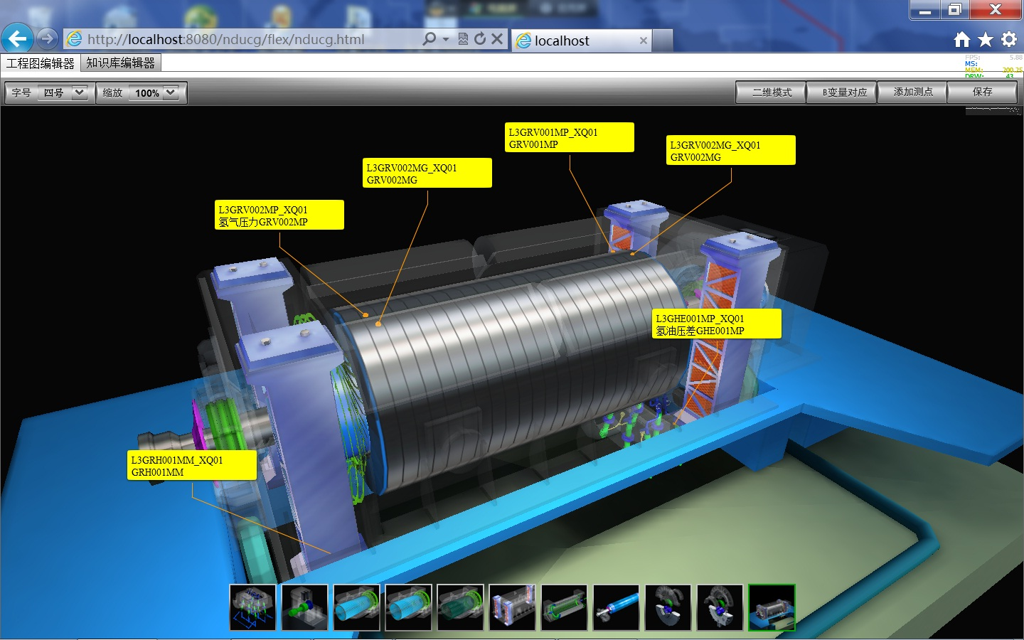
Parallelly Place Failures And Signals on the 3D Graph

Slide 18
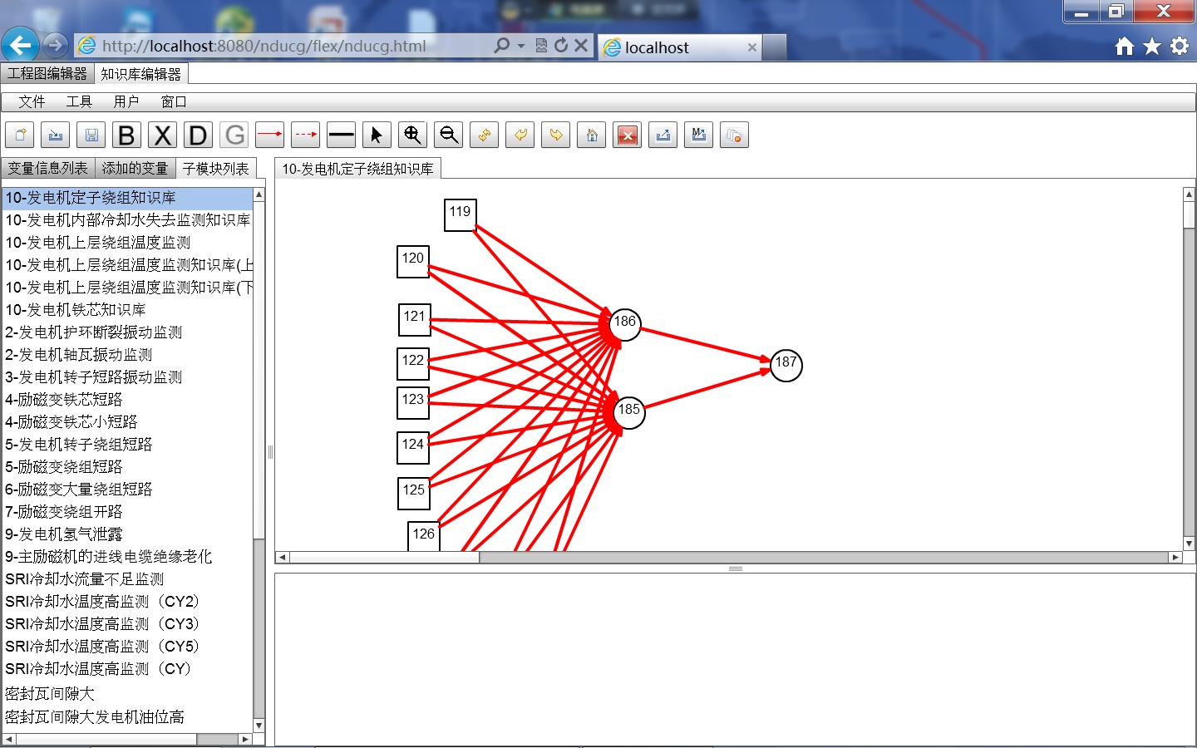
Construct DUCG Modules

Slide 19
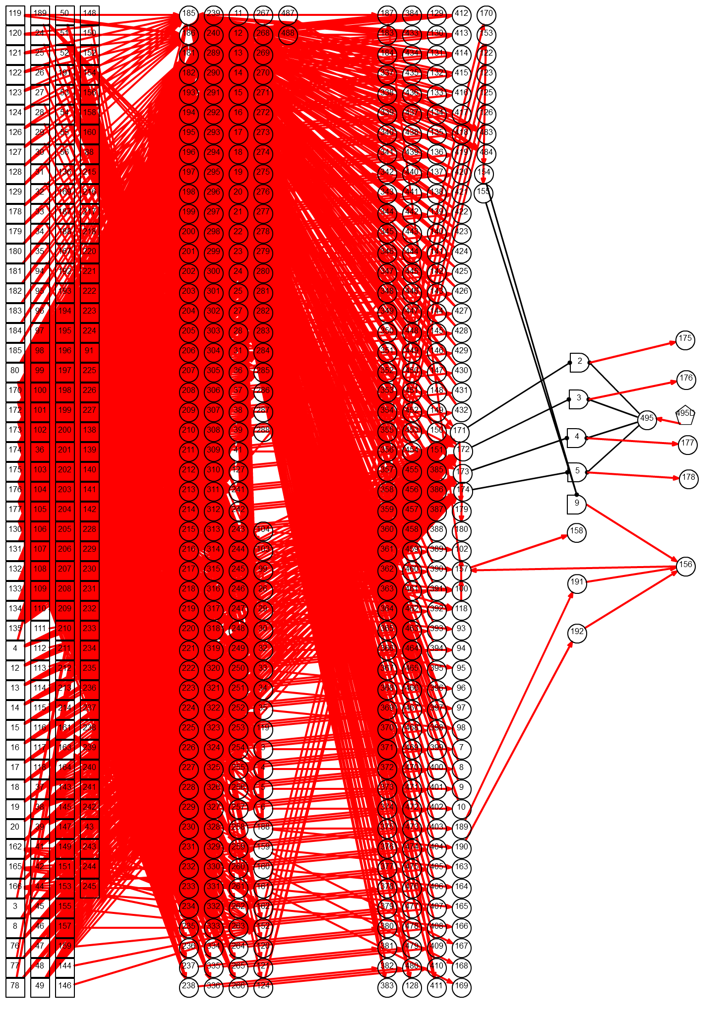
Synthesize Modules as the DUCG for a Generator of a NPP
岭东核电站发电机DUCG模型，包含633个变量，由32个DUCG模块合成。其中B变量205个，X变量427个，G变量5个，D变量1个，因果关系矩阵（有向弧）2952个。

Slide 20
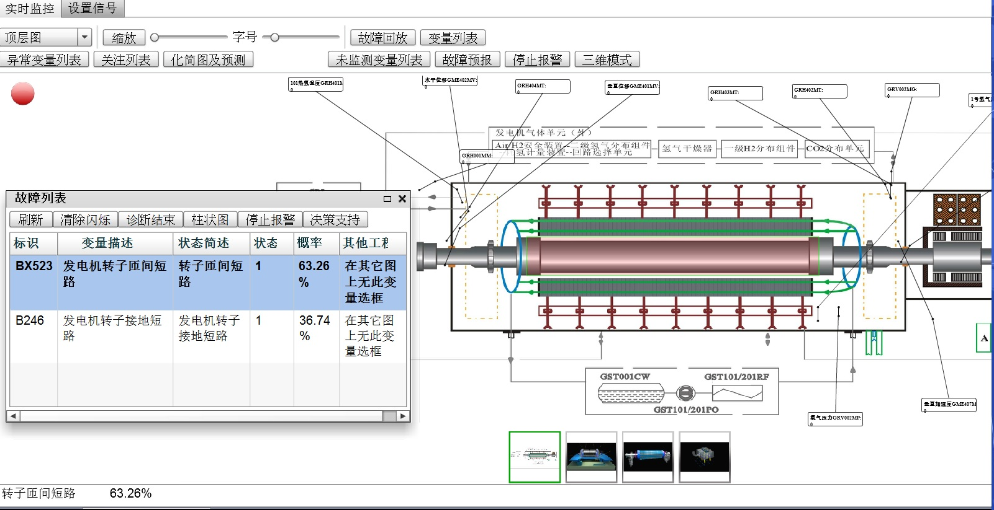
Display Diagnosis on 2D Graph and in Table

Slide 21
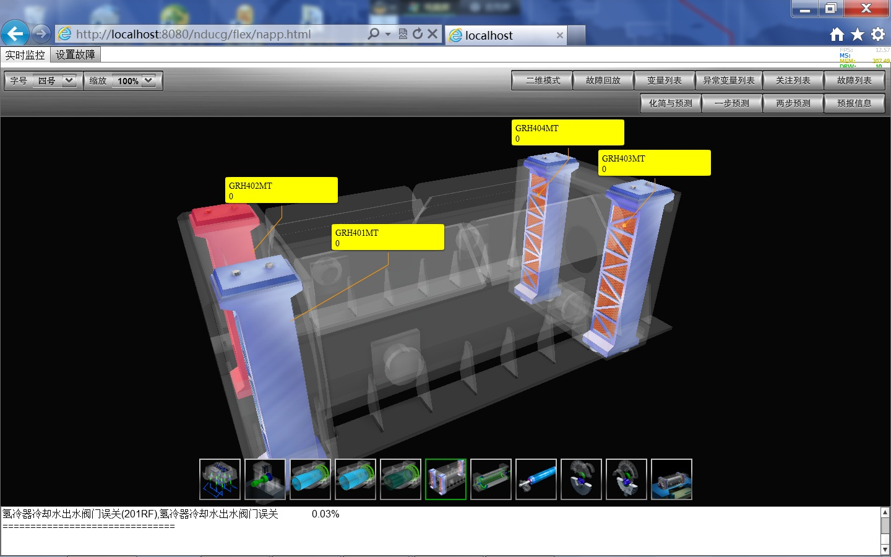
Display Diagnosis on 3D Graph

Slide 22
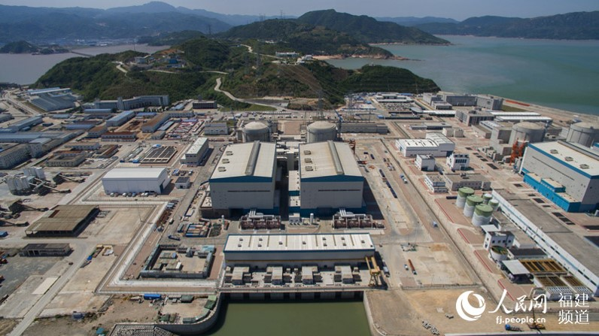
Fault Diagnosis For the Secondary Loop of NingDe NPP

Slide 23
Publications
C. Dong, Q. Zhang. “The Cubic Dynamic Uncertain Causality Graph: A Methodology for Temporal Process Modeling and Diagnostic Logic Inference,” IEEE Trans. Neural Networks and Learning Systems, vol. 31, no. 10, pp. 4239-4253, 2020.
Y. Zhao, Q. Zhang and C. Dong. Application of DUCG in fault diagnosis of nuclear power plant secondary loop. Automatic Science and Technology, vol. 48, pp. 496-501, 2014.
C. Dong, Y. Zhao, Q. Zhang. Cubic causality modeling and uncertain inference method for dynamic fault diagnosis, J. Tsinghua Univ. (Science & Technol), vol. 58, no. 7, pp. 614-622, 2018.

Slide 24
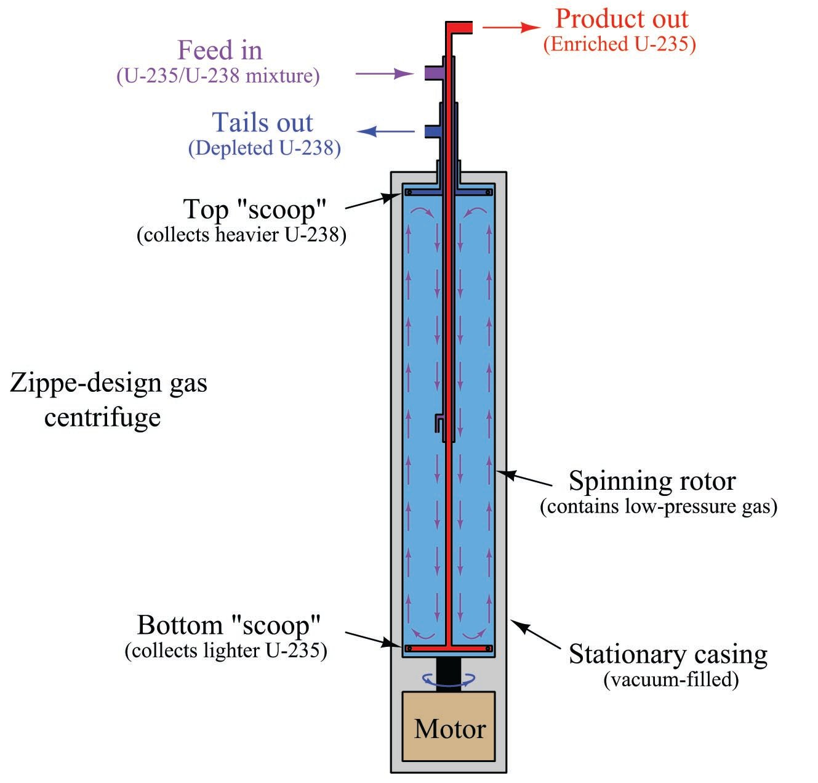
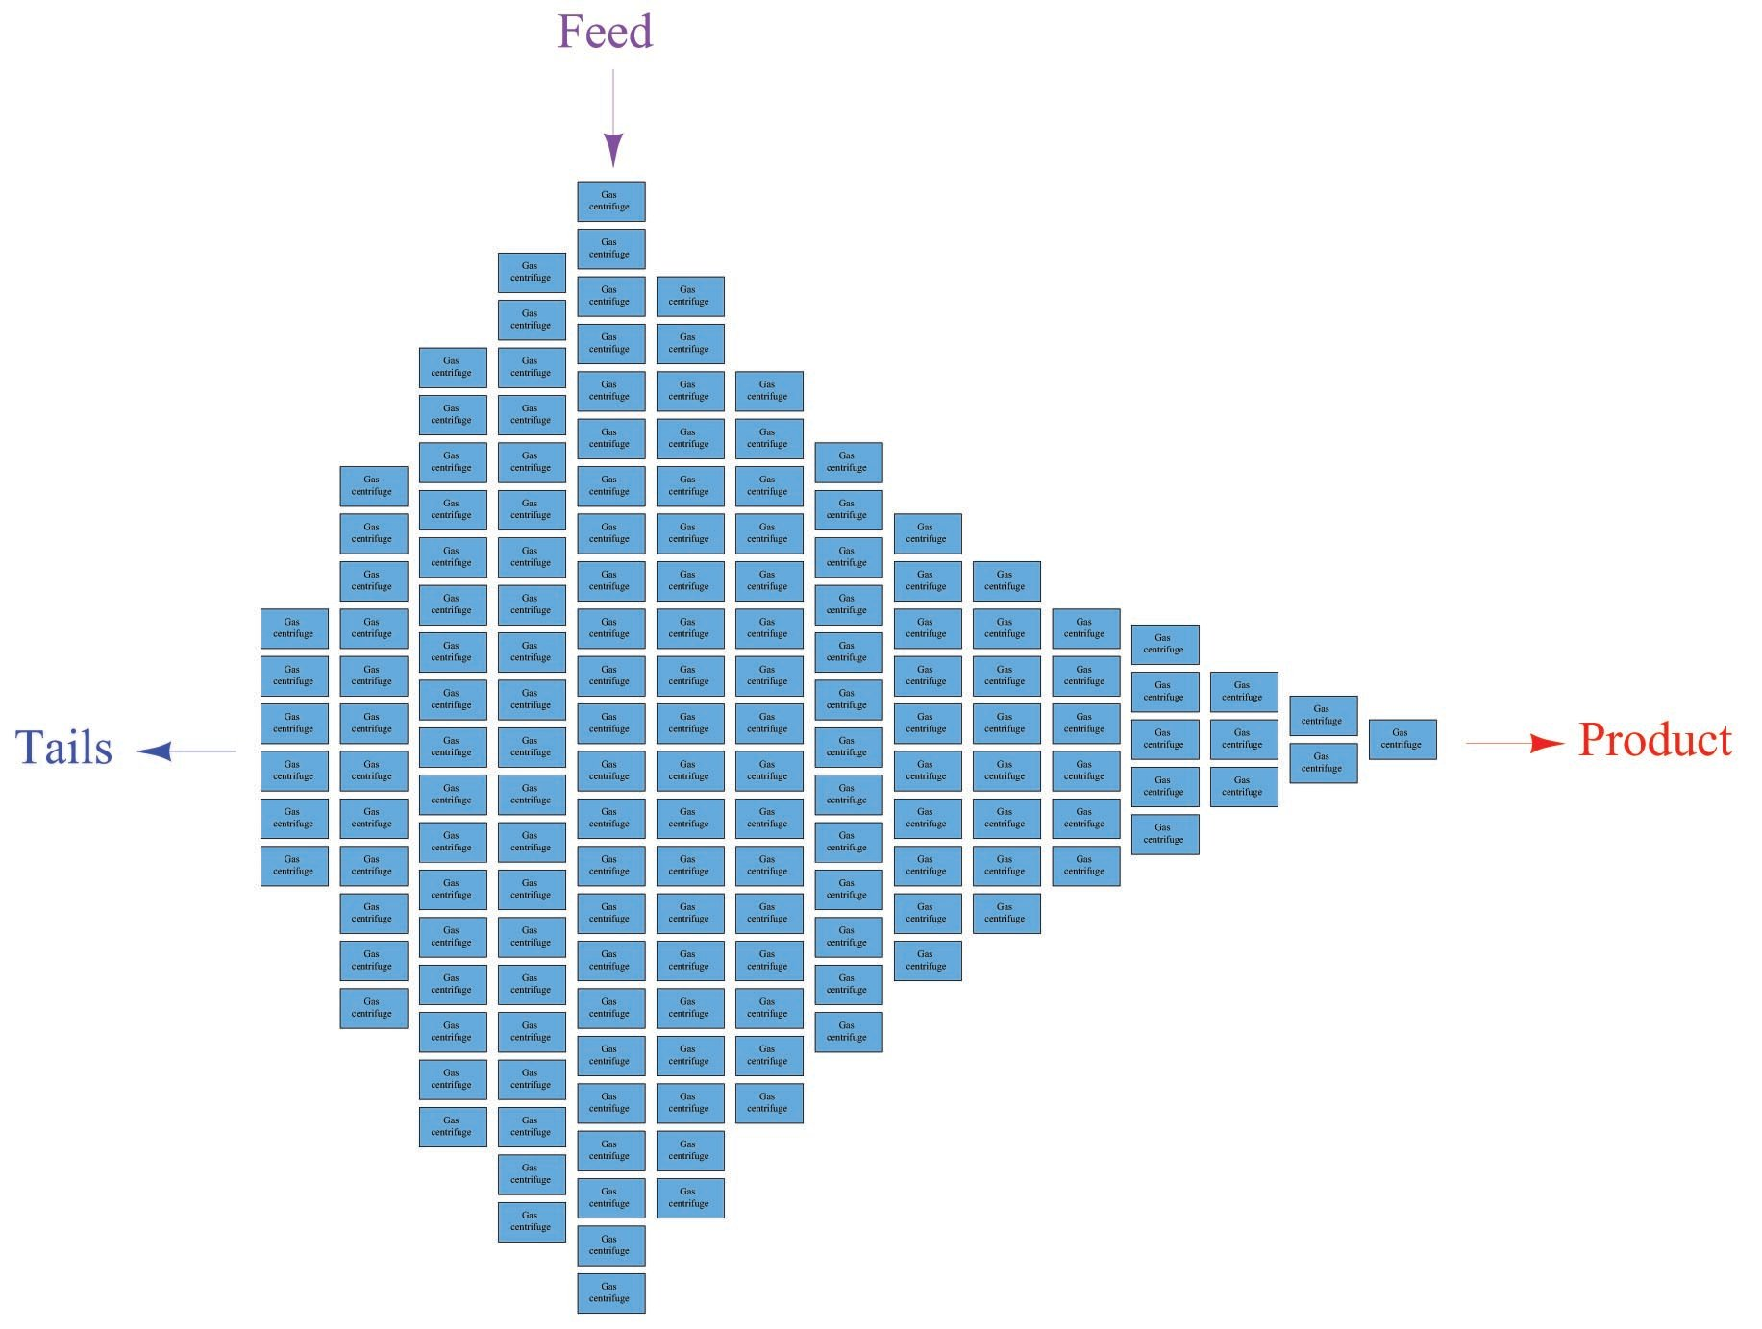
Uranium-235 Nuclear Fuel Isotope Separation System

Slide 25
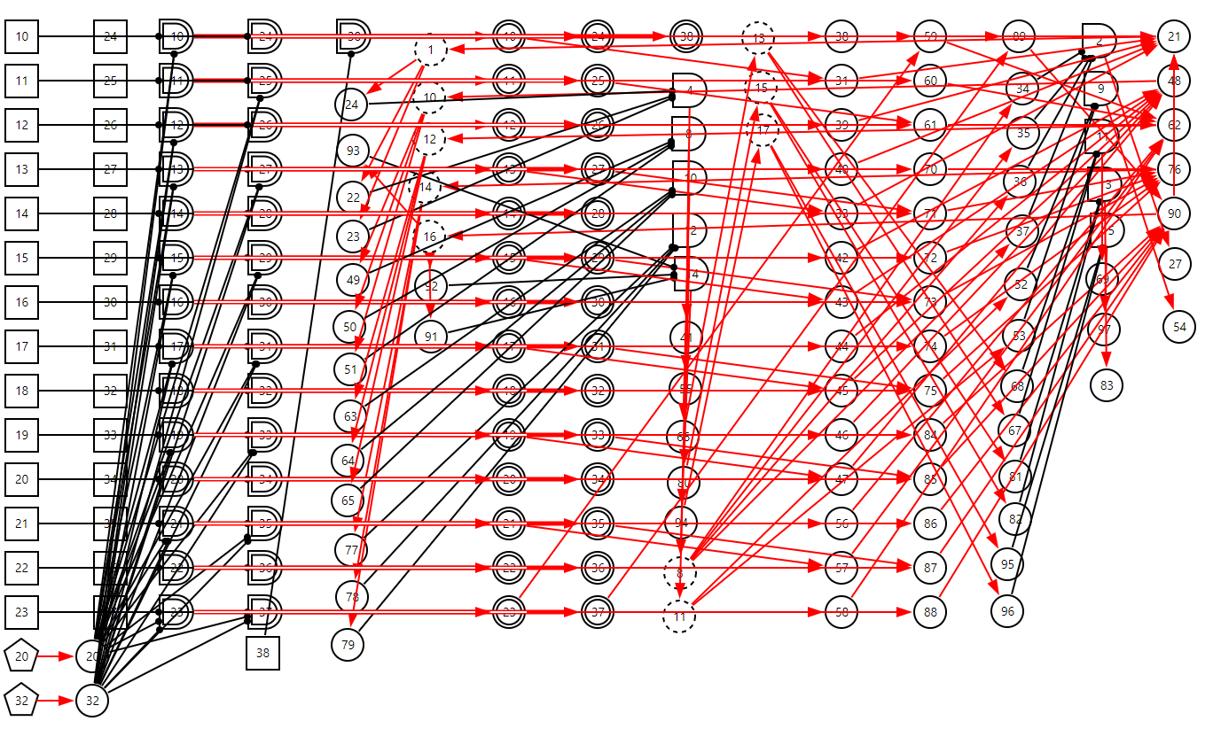
DUCG for the Fault Diagnosis of the Separation System

Slide 26
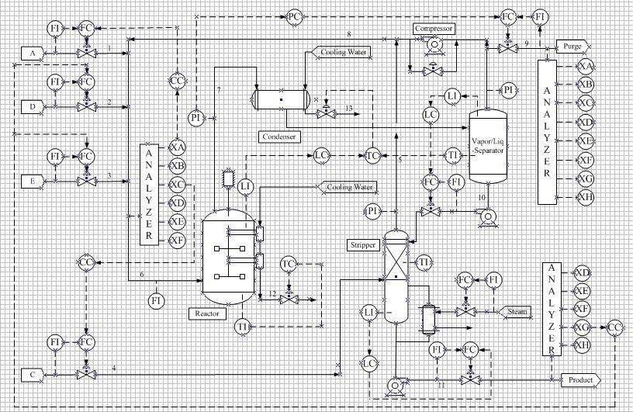
TE Chemical System
Sylvain Verron, Teodor Tiplica and Abdessamad Kobi. Monitoring of Complex Processes with Bayesian Networks, Bayesian Network, Ahmed Rebai (Ed.). 2010.

Slide 27
Training and Testing of DBN
Class | Train data | Test data
Fault free | 480 | 800
Fault 1 | 480 | 800
Fault 2 | 480 | 800
. . . | . . . | . . .
Fault k | 480 | 800
. . . | . . . | . . .
Fault 20 | 480 | 800

Slide 28
Fault Diagnoses of DBN
Fault | Diagnosis rate
1 | 97.5%
2 | 98.12%
3 | 22%
4 | 82.37%
5 | 98%
6 | 100%
7 | 100%
8 | 97%
9 | 22.62%
10 | 86.87%
11 | 75.5%
12 | 98.25%
13 | 76.12%
14 | 98.75%
15 | 23.5%
16 | 80.62%
17 | 85%
18 | 68.5%
19 | 96.12%
20 | 87.37%
Mean | 79.71%

Slide 29
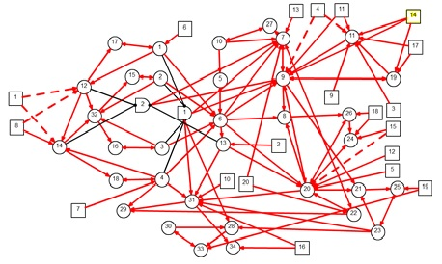
DUCG for TE System

Slide 30
Fault Diagnoses of DUCG for TE System
Fault | Rank Probability
1 | 100%
2 | 100%
3 | 94.77%
4 | 97.28%
5 | 80%
6 | 100%
7 | 100%
8 | 100%
9 | 94.97%
10 | 100%
11 | 96.85%
12 | 100%
13 | 100%
14 | 100%
15 | 100%
16 | 100%
17 | 99.32%
18 | 100%
19 | 100%
20 | 100%
Mean | 98.16%

Slide 31
Publication
Y. Qu, Q. Zhang and X. Zhu. Application of dynamic uncertain causality graph to dynamic fault diagnosis in chemical processes, CAAI Trans. Intelligent Systems, vol. 10, no. 3, pp. 354-361, 2015.

Slide 32
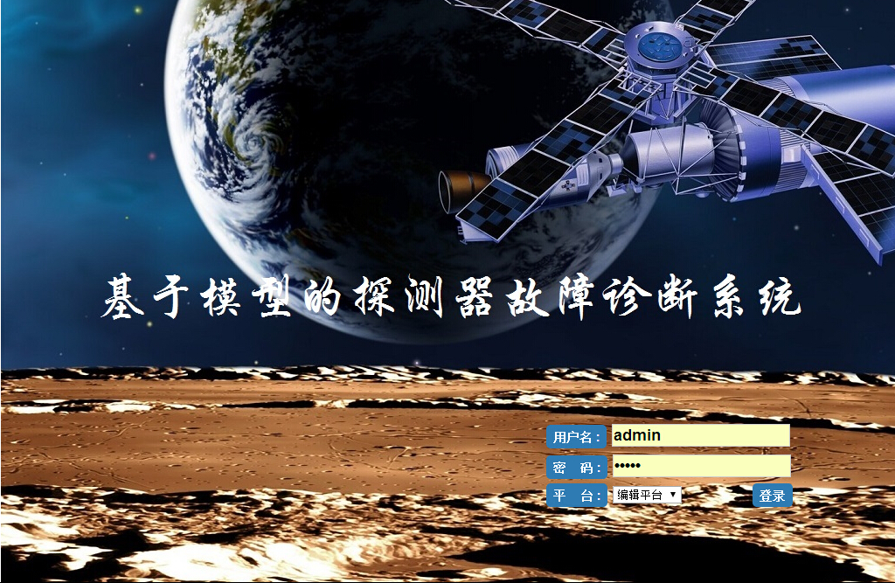
Fault Diagnosis for a Satellite System

Slide 33
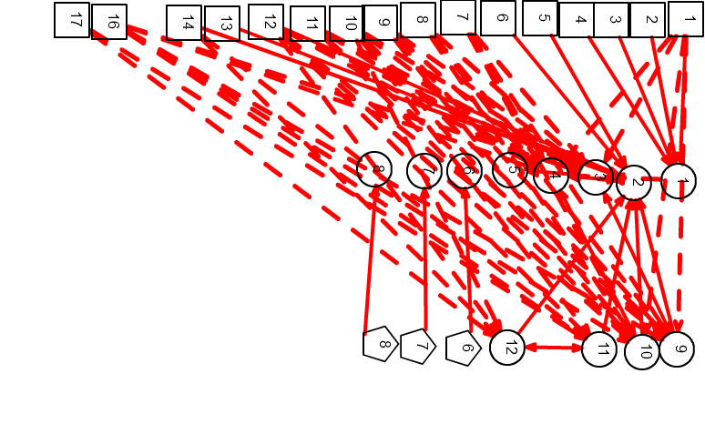
DUCG for the Power System of a Satellite

Slide 34
Diagnosis Results
Correctness is 100% for all 26 faults in generator of a NPP.
Correctness is 100% for all 24 faults in secondary loop of NingDe NPP.
Correctness is 100% for all 29 faults in Uranium-235 Nuclear Fuel Isotope Separation System.
Correctness is 100% for all 16 faults in the Power System of a Satellite.
So far, all diagnoses and predictions are 100% correct.

Slide 35
PSA of a Boiling-Water Reactor Issued by IAEA
IAEA-TECDOC-590

Slide 36
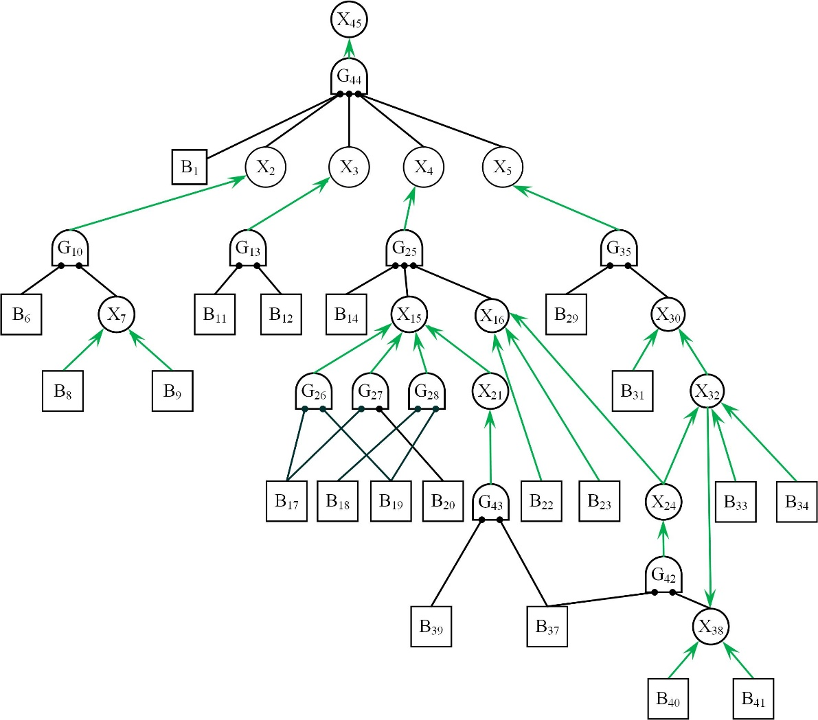
Transfer ET and FTs as DUCG, Compared With Risk Spectrum
DUCG:
2.31 × 10⁻⁵/yr
Risk Spectrum:
2.12 × 10⁻⁵/yr
2.31 × 10⁻⁵/yr
7.04 × 10⁻⁵/yr
7.04 × 10⁻⁵/yr
Error range:
-9.0%~+305.8%
Uncertainties can be added
Dependencies and logic cycle

Slide 37
Publication
Zhenxu Zhou, Qin Zhang. “Model event/fault trees with dynamic uncertain causality graph for better probabilistic safety assessment,” IEEE Trans. Reliability, vol. 66, no. 1, pp 178-188, 2017.

Slide 38
Single-Valued S-DUCG
Parent events：
Parent variables：
V1
V2
Vm
…
Child variable：
Xn
Child event
Decoupling variables and parameters

Slide 39
Multiple Valued M-DUCG
Parent events：
Parent variables：
V1
V2
…
Vm
Child variable：
Xn
Child event
Decoupling variables and parameters

Slide 40
Thanks！Questions Are Welcome
Qin Zhang
qinzhang@tsinghua.edu.cn；614839376@qq.com

